Slide 1



RACLE
AIA 2 2024/2025
Made by: Samuel Zárecký, Aleš Hrehuš, Tomáš Nyulassy

Slide 2
RACLE
AIA 2 2024/2025
Made by: Samuel Zárecký, Aleš Hrehuš, Tomáš Nyulassy

Slide 3
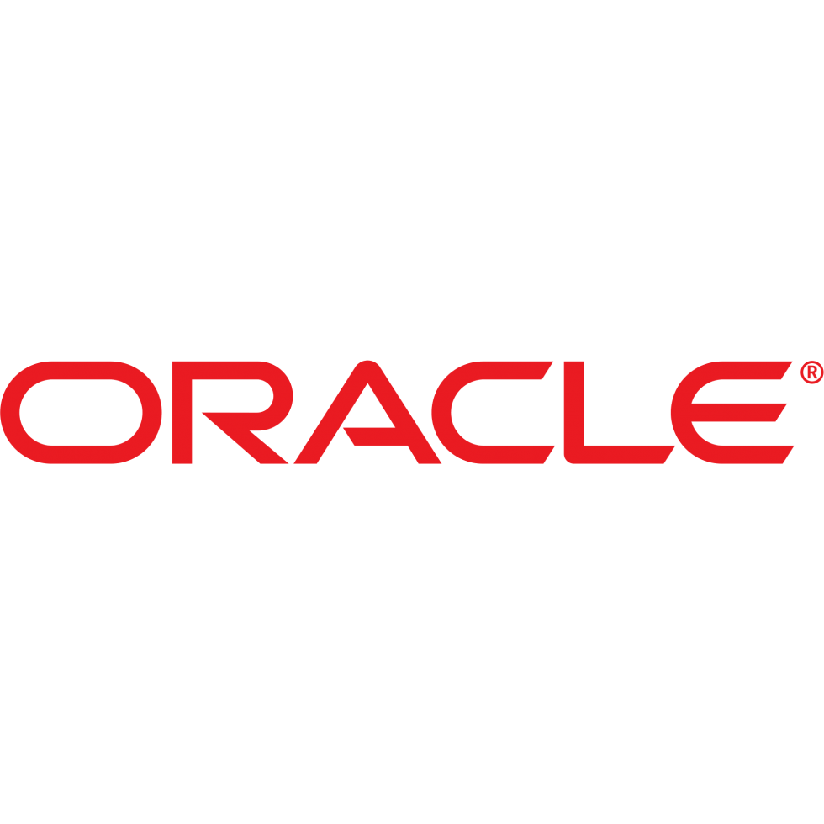
Content
History of Oracle
Founders & Founding Story
Market the company operates in
Subsidiaries
Employees – number and roles
Profit – General Financial Overview

Slide 4
History of Oracle
Announced plans to move global HQ to Nashville, TN
Introduced Autonomous Database (AI/machine learning-powered)
Acquired Sun Microsystems (gaining Java, MySQL, and Solaris technologies)
Cloud expansion begins - launch of Oracle Cloud
2024
Founded as Software Development Laboratories (SDL)
Secured first major client - the CIA
Renamed to Relational Software Inc
2018
2010s
2010
1980s
1979
1977

Slide 5
Content
History of Oracle
Founders & Founding Story
Market the company operates in
Subsidiaries
Employees – number and roles
Profit – General Financial Overview

Slide 6
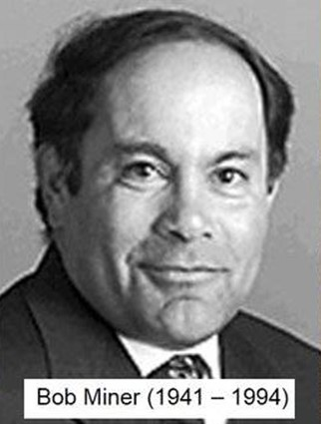
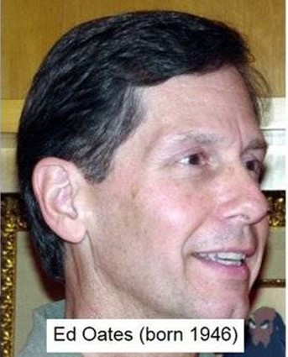
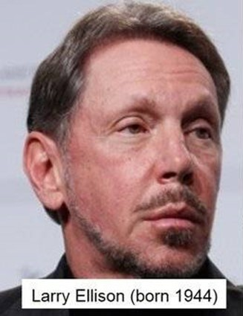
Founders & Founding Story
Larry Ellison
Bob Miner
Ed Oates

Slide 7
Founders & Founding Story
Larry Ellison
Bob Miner
Ed Oates

Slide 8
Founders & Founding Story

Slide 9
Founders & Founding Story

Slide 10
Founders & Founding Story
Inspiration:
Ellison was inspired by Edgar F. Codd’s (IBM) research paper on relational databases, which laid the foundation for Oracle’s technology.
Where are they now?
Larry Ellison: Still active – Executive Chairman & CTO of Oracle
Bob Miner: Passed away in 1994 (cancer). Led Oracle’s technical development during its early years
Ed Oates: Left Oracle later, pursued music and smaller entrepreneurial ventures

Slide 11
Content
History of Oracle
Founders & Founding Story
Market the company operates in
Subsidiaries
Employees – number and roles
Profit – General Financial Overview

Slide 12
Market the company operates in
Core Business Areas
Enterprise Software (ERP, CRM, HCM, SCM)
Database Systems (Oracle Database)
Cloud Services (Oracle Cloud Infrastructure, Oracle Cloud Platform)
Hardware (servers, storage, engineered systems)
Consulting Services
Key Markets
United States,
Europe, Asia,
Middle East

Slide 13
Market the company operates in

Slide 14
Content
History of Oracle
Founders & Founding Story
Market the company operates in
Subsidiaries
Employees – number and roles
Profit – General Financial Overview

Slide 15
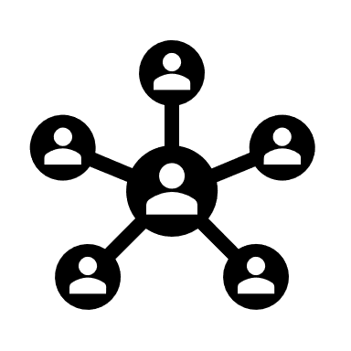
Subsidiaries
cloud services,
database technologies,
analytics,
artificial intelligence (AI)
Key Subsidiaries
Sun Microsystems (Acquired 2010) – Java, Solaris, MySQL
NetSuite (Acquired 2016) – Cloud ERP for SMBs
Cerner (Acquired 2022) – Healthcare IT solutions

Slide 16
Content
History of Oracle
Founders & Founding Story
Market the company operates in
Subsidiaries
Employees – number and roles
Profit – General Financial Overview

Slide 17

Employees – number and roles
Employees in 2024:
159 000 worldwide
50-99 in Slovakia
Roles:
Software Engineer / Developer
– Maintains software products
Database Administrator (DBA)
– Manages Oracle databases
Cloud Architect
– Designs and oversees the deployment of Oracle Cloud infrastructure
Technical Support Engineer
– Provides support for Oracle products

Slide 18
Employees – number and roles
Roles:
Solutions Architect
– Ensuring integration with existing systems
Quality Assurance (QA) Engineer
– Tests Oracle software products
Security Engineer
– Secures Oracle systems
Systems Administrator
– Manages Oracle IT infrastructure
…

Slide 19
Content
History of Oracle
Founders & Founding Story
Market the company operates in
Subsidiaries
Employees – number and roles
Profit – General Financial Overview

Slide 20

Profit – General Financial Overview
2024 Full-Year Revenue: Total revenue: $53.0 billion (6% increase)
Stock Performance: Oracle shares rose by 60% in 2024, their best performance since 1999
Stock Price: Current price: $132.35 per share
Outlook: Continued growth expected in cloud services and artificial intelligence (AI)

Slide 21
Profit – General Financial Overview

Slide 22
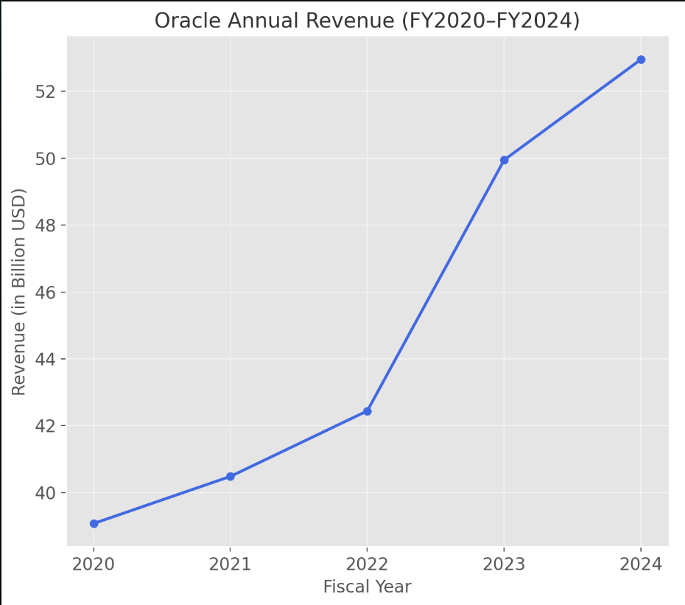
Profit – General Financial Overview

Slide 23
Funfact
Oracle's first product being called Version 2 instead of Version 1
Why?
To create the illusion of maturity and stability
The goal was to build trust in a competitive, skeptical market.
Did it work?
The strategy boosted Oracle’s credibility.
“fake it ’til you make it”

Slide 24
Sources
Forbes.sk. (2024). Larry Ellison – Oracle Corporation: Majetok, biznis, životopis. Source: https://www.forbes.sk/larry-ellison-oracle-corporation-majetok-biznis-zivotopis/
Oracle Corporation Revenue. (2024). Oracle revenue 2010-2024. Macrotrends. Source: https://www.macrotrends.net/stocks/charts/ORCL/oracle/revenue
Statista. (2024). Oracle's revenue by business segment from 2015 to 2024. Source: https://www.statista.com/statistics/269728/oracles-revenue-by-business-segment/
CNBC. (2020, December 11). Oracle is moving its headquarters from Silicon Valley to Austin, Texas. Source: https://www.cnbc.com/2020/12/11/oracle-is-moving-its-headquarters-from-silicon-valley-to-austin-texas.html
Oracle. (2025). Oracle | Cloud Applications and Cloud Platform. Source: https://www.oracle.com/il-en/

